Slide 1
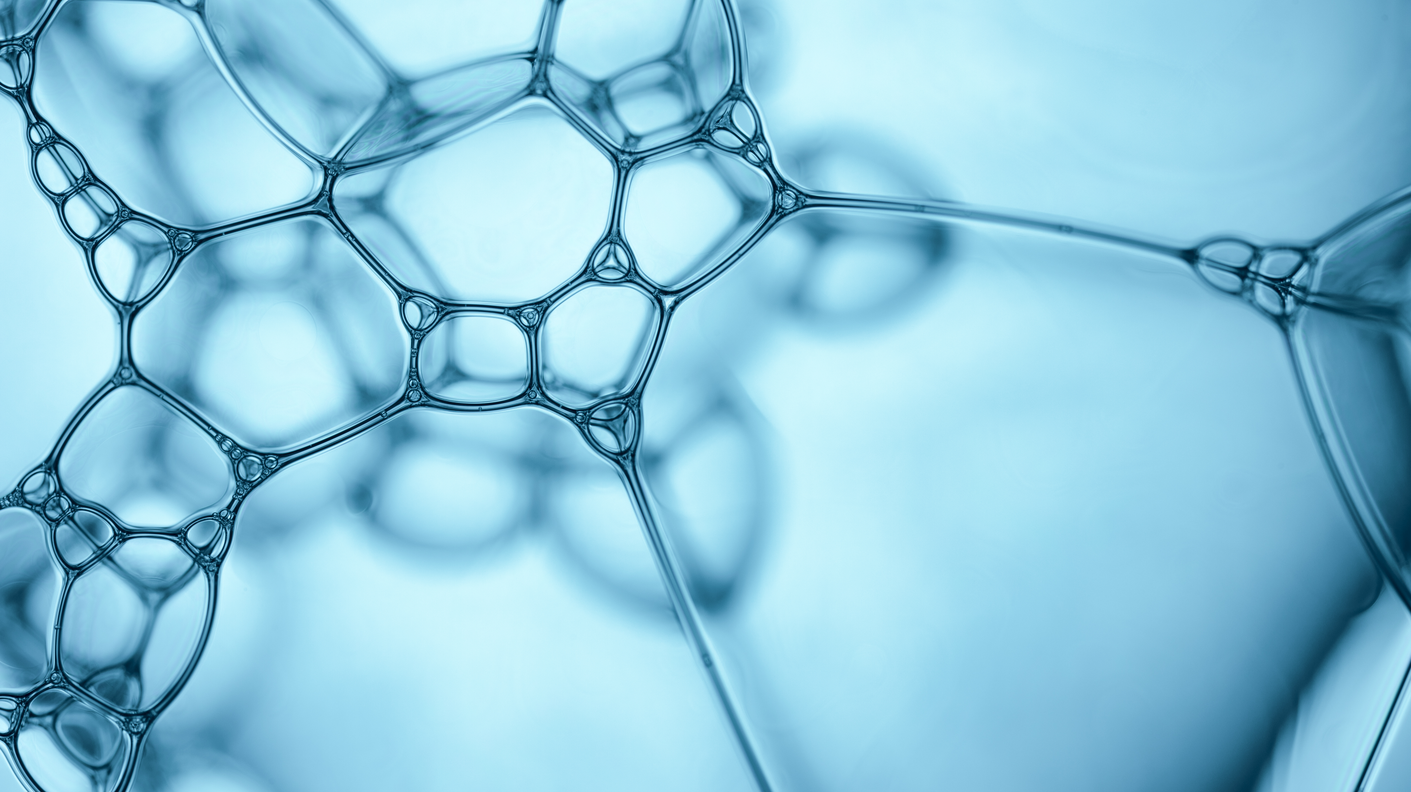
Detection of Parkinson's Disease

Slide 2
AGENDA
INTRODUCTION
CAUSES OF PARKINSON'S DISEASE
SYMPTOMS OF PARKINSON'S DISEASE
COMPLICATIONS
TREATMENT OF PARKINSON'S DISEASE
DETECTION OF PARKINSON’S DISEASE USING PYTHON

Slide 3
INTRODUCTION
Parkinson's Disease is a progressive disorder that affects the nervous system and the parts of the body controlled by the nerves. Symptoms start slowly. The first symptom may be a barely noticeable tremor in just one hand. Tremors are common, but the disorder may also cause stiffness or slowing of movement.
In the early stages of Parkinson's disease, your face may show little or no expression. Your arms may not swing when you walk. Your speech may become soft or slurred. Parkinson's disease symptoms worsen as your condition progresses over time.
Although Parkinson's disease can't be cured, medications might significantly improve your symptoms. Occasionally, your health care provider may suggest surgery to regulate certain regions of your brain and improve your symptoms.

Slide 4
CAUSES OF PARKINSON'S DISEASE
When dopamine levels decrease, it causes atypical brain activity, leading to impaired movement. The exact cause for this decrease in dopamine level is still unknown but several factors may play a role, which are : Genes Environmental triggers The presence of Lewy bodies

Slide 5
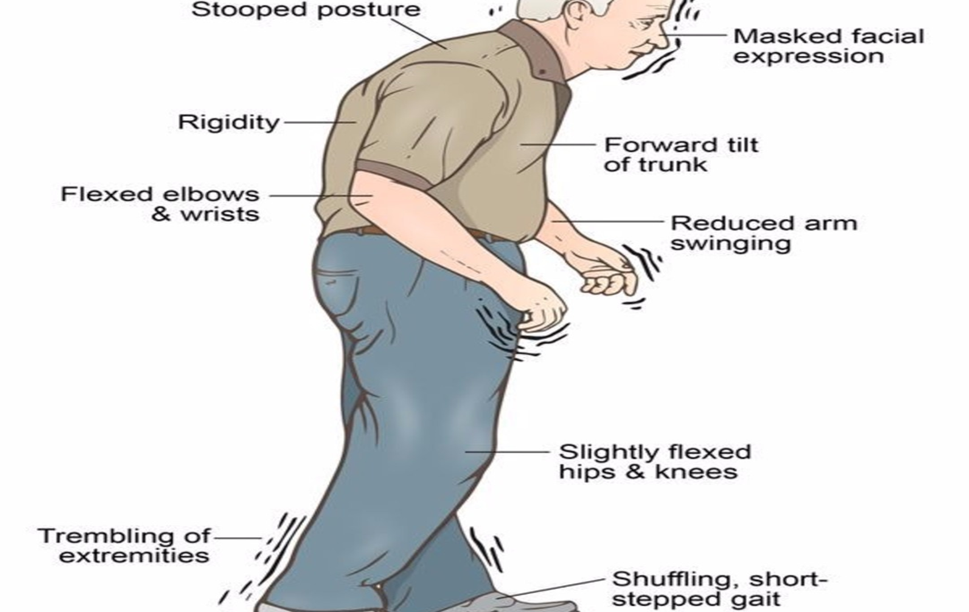

Slide 6
COMPLICATIONS
-Thinking difficulties. -Depression and emotional changes. -Swallowing problems. -Chewing and eating problems. -Sleep problems and sleep disorders. -Constipation.

Slide 7
SYMPTOMS OF PARKINSON'S DISEASE
Tremors, Trembling of hands, arms, legs, jaw and face
Stiffness of the arms, legs and trunk
Slowness of movement
Poor balance and coordination
Speech difficulty

Slide 8
TREATMENT OF PARKINSON'S DISEASE
Parkinson's disease cannot be cured, but medications can help control symptoms. In some later cases, surgery may be advised. Some research has shown that regular aerobic exercise might reduce the risk of Parkinson's disease.
Some other research has shown that people who consume caffeine — which is found in coffee, tea and cola — get Parkinson's disease less often than those who don't drink it. Green tea is also related to a reduced risk of developing Parkinson's disease. However, it is still not known whether caffeine protects against getting Parkinson's or is related in some other way.

Slide 9
ABOUT THE DATASET
This dataset is composed of a range of biomedical voice measurements from 31 people, 23 with Parkinson's disease (PD). Each column in the table is a particular voice measure, and each row corresponds to one of 195 voice recordings from these individuals ("name" column). The main aim of the data is to differentiate healthy people from those with PD, according to the "status" column which is set to 0 for healthy and 1 for PD.
The data is in ASCII CSV format. The rows of the CSV file contain an instance corresponding to one voice recording. There are around six recordings per patient, the name of the patient is identified in the first column.

Slide 10
DATASET ATTRIBUTE INFORMATION
Matrix column entries (attributes):
name - ASCII subject name and recording number
MDVP:Fo(Hz) - Average vocal fundamental frequency
MDVP:Fhi(Hz) - Maximum vocal fundamental frequency
MDVP:Flo(Hz) - Minimum vocal fundamental frequency
MDVP:Jitter(%), MDVP:Jitter(Abs), MDVP:RAP, MDVP:PPQ, Jitter:DDP - Several measures of variation in fundamental frequency
MDVP:Shimmer,MDVP:Shimmer(dB),Shimmer:APQ3,Shimmer:APQ5,MDVP:APQ,Shimmer:DDA - Several measures of variation in amplitude
NHR, HNR - Two measures of the ratio of noise to tonal components in the voice
status - The health status of the subject (one) - Parkinson's, (zero) - healthy
RPDE, D2 - Two nonlinear dynamical complexity measures
DFA - Signal fractal scaling exponent
spread1,spread2,PPE - Three nonlinear measures of fundamental frequency variation

Slide 11
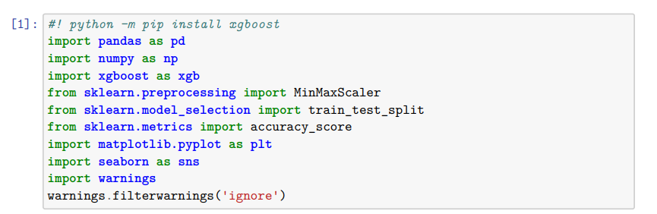
IMPORT LIBRARIES

Slide 12
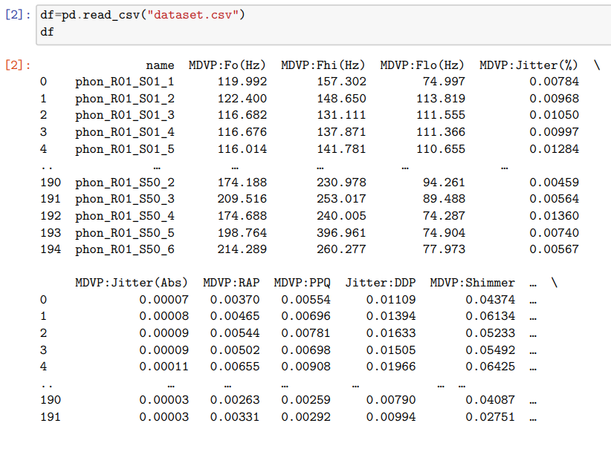
LOADING DATASET

Slide 13
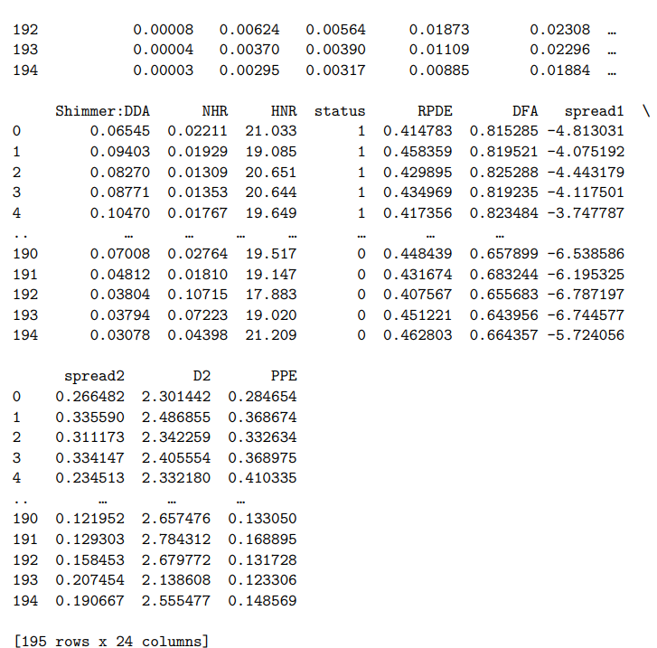
LOADING DATASET

Slide 14
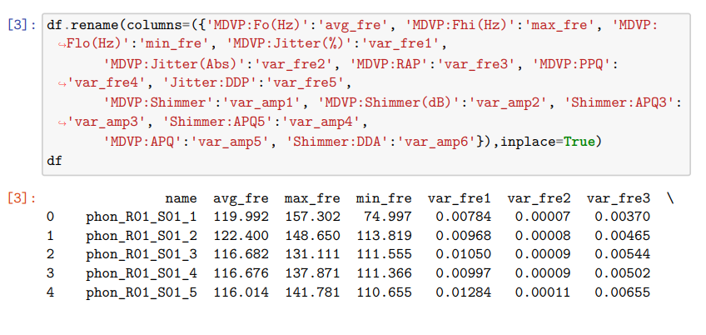
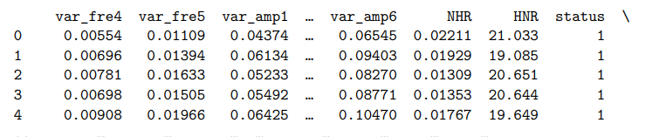
RENAME DATASET

Slide 15
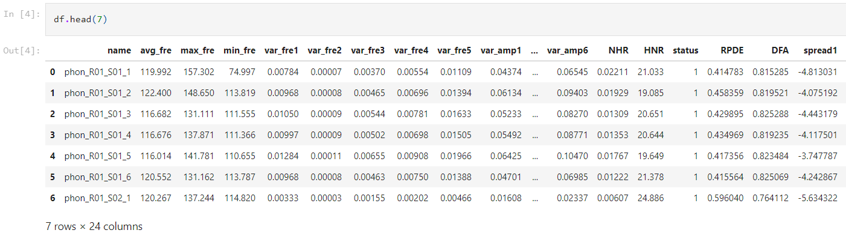
DIMENSIONAL ANALYSIS OF DATASET

Slide 16
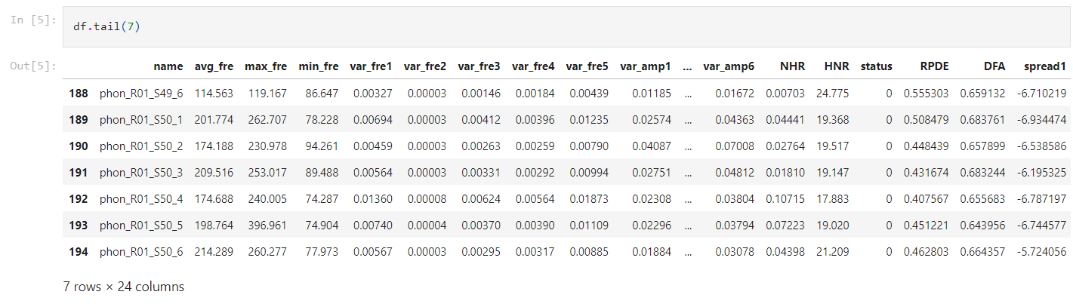
DIMENSIONAL ANALYSIS OF DATASET

Slide 17
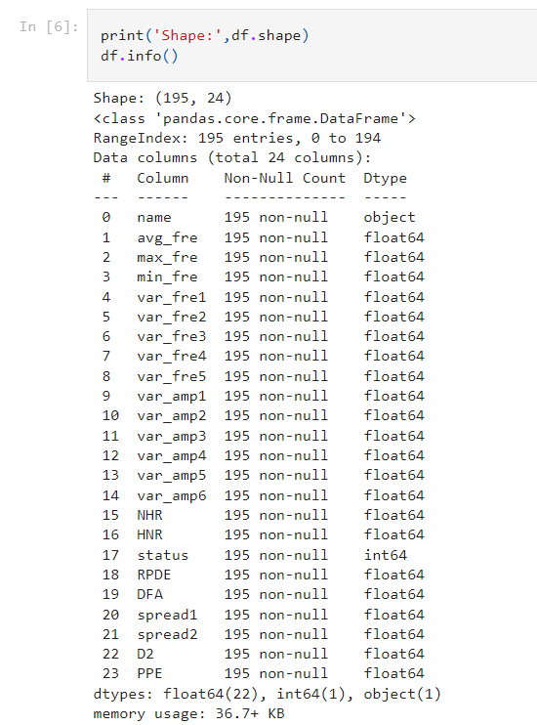
DIMENSIONAL ANALYSIS OF DATASET

Slide 18
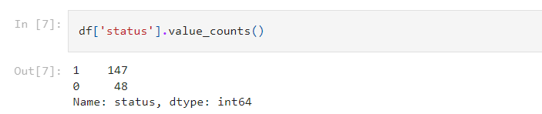
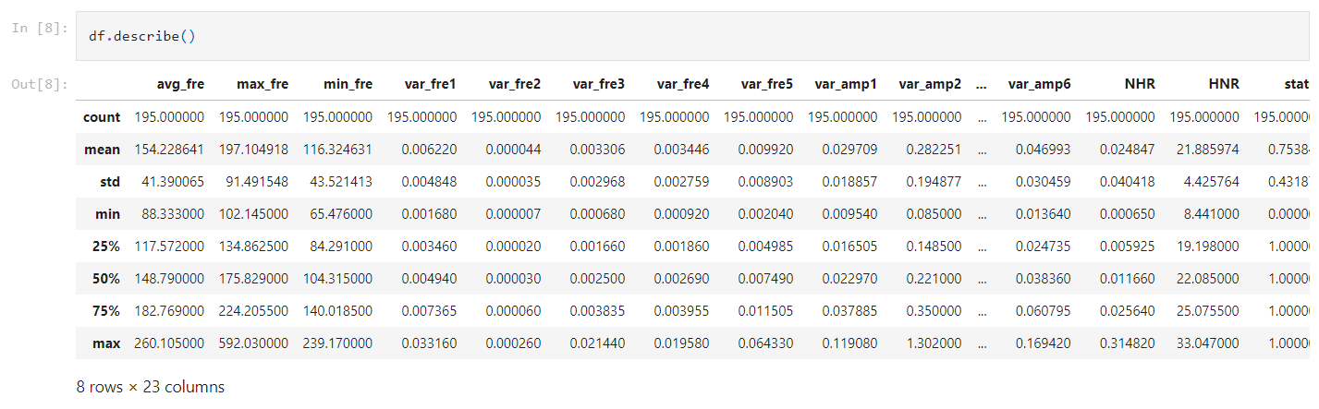
DIMENSIONAL ANALYSIS OF DATASET

Slide 19
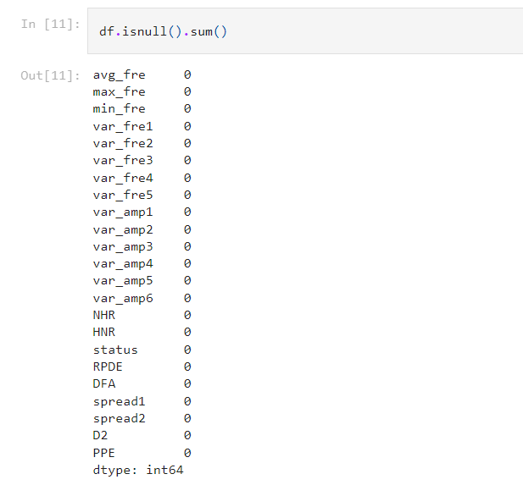
DATA CLEANING

Slide 20
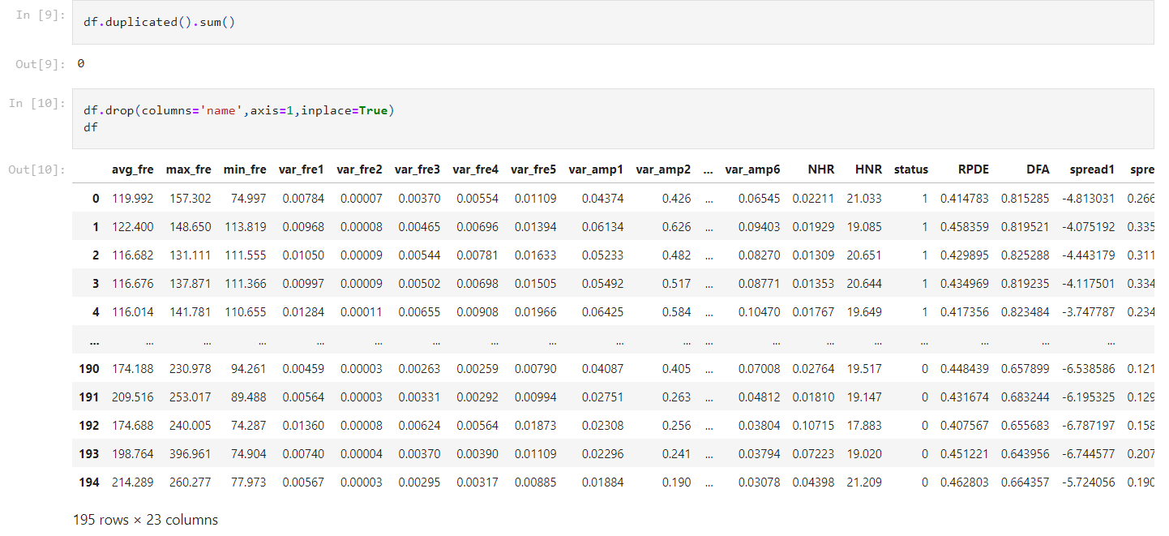
DATA CLEANING

Slide 21
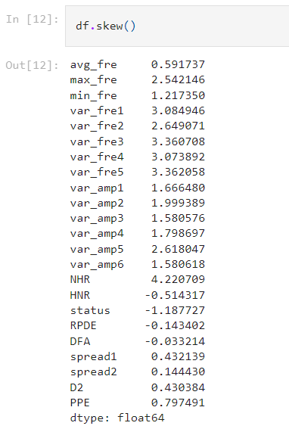
OUTLIER DETECTION

Slide 22
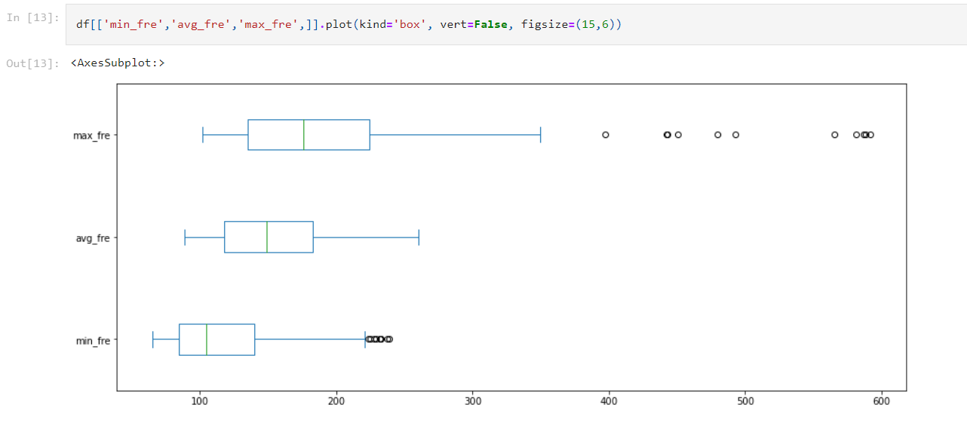
OUTLIER DETECTION

Slide 23
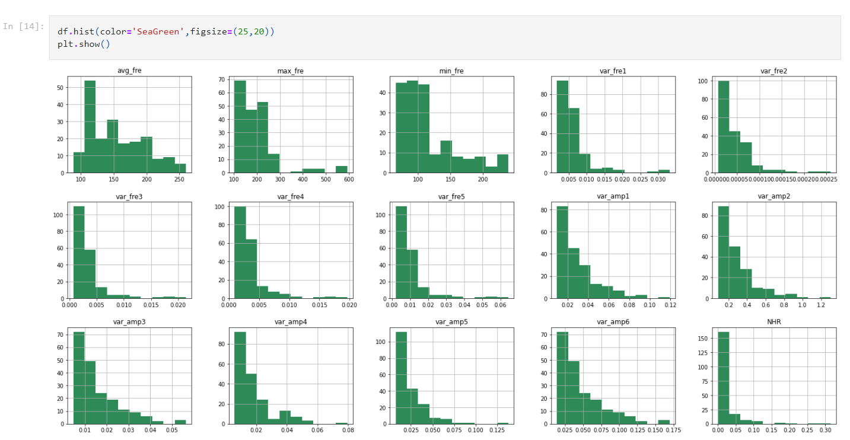
DATA VISUALIZATION

Slide 24
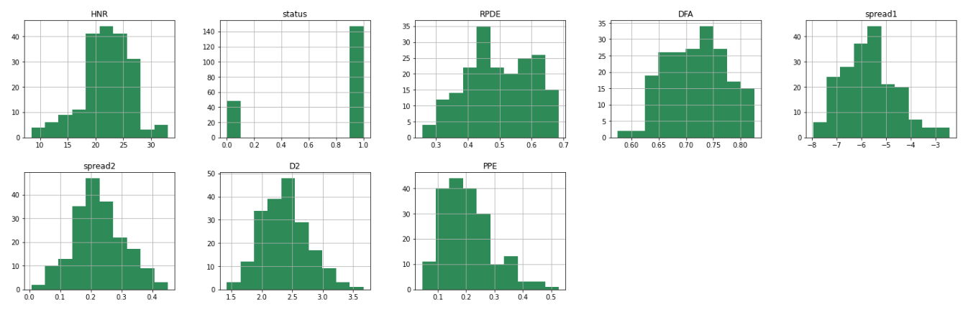
DATA VISUALIZATION

Slide 25
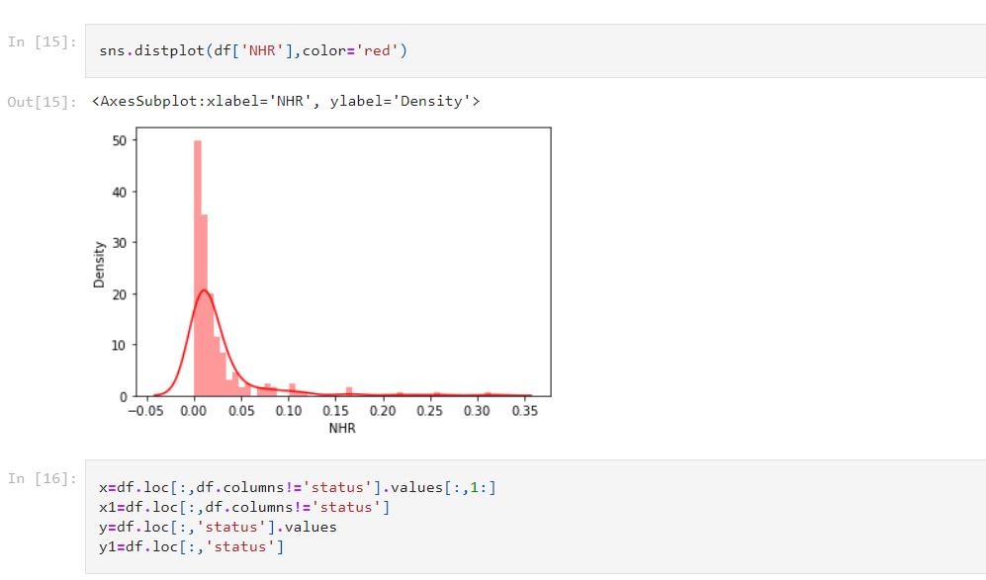
DATA VISUALIZATION

Slide 26
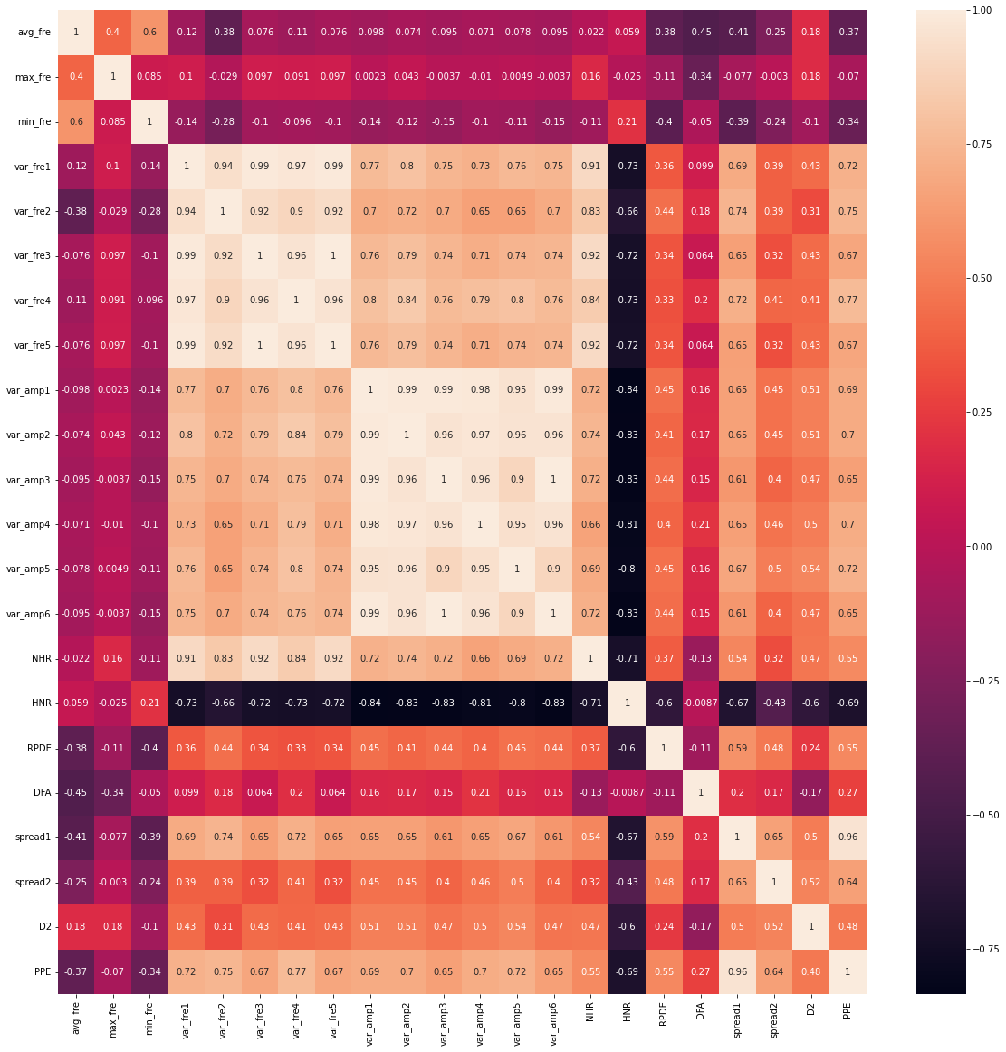
DATA VISUALIZATION

Slide 27
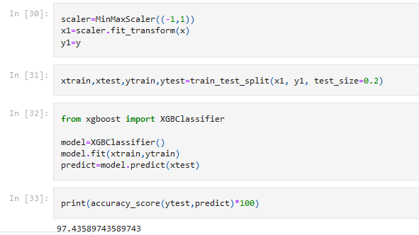
MODEL CREATION FOR PREDICTION

Slide 28
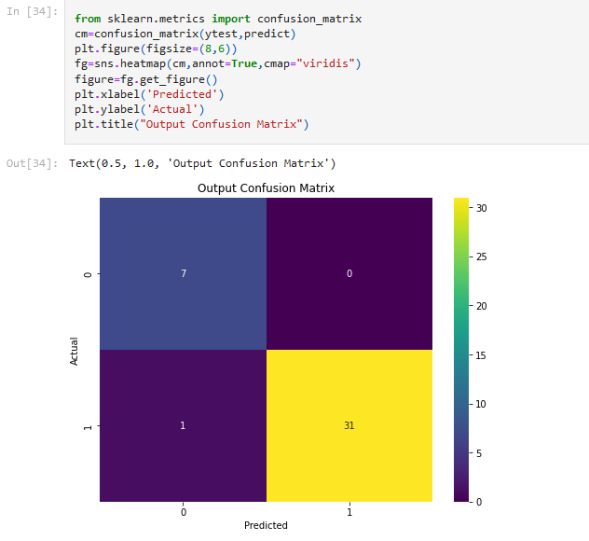
MODEL CREATION FOR PREDICTION

Slide 29
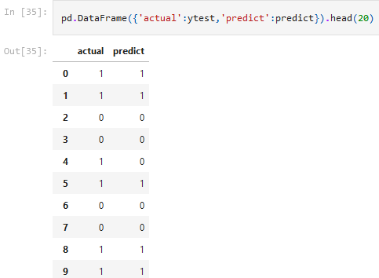
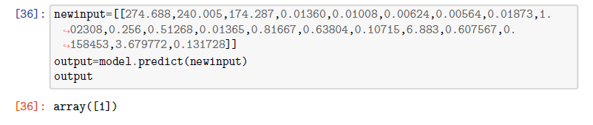
PREDICTION RESULT

Slide 30
CONCLUSION, REFERENCES & GITHUB LINK
Conclusion:
Our model predicts POSITIVE(+ve) Parkinson’s Disease for the following data input:
[274.688,240.005,174.287,0.01360,0.01008,0.00624,0.00564,
0.01873,1.02308,0.256,0.51268,0.01365,0.81667,0.63804,0.10715,
6.883,0.607567,0.158453,3.679772,0.131728] with an accuracy of 97.43%
Dataset Reference:
Max A. Little, Patrick E. McSharry, Eric J. Hunter, Lorraine O. Ramig (2008), 'Suitability of dysphonia measurements for telemonitoring of Parkinson's disease', IEEE Transactions on Biomedical Engineering (to appear).
GitHub Link:
https://github.com/kartikdhari15/DATA_ANALYTICS_COLLEGE_PROJECT.git

